Slide 1

MIT School of Engineering & Sciences, Pune
Department of Electronics and Communication Engineering
“Wireless EV Charging Stations”
Group Code: ECO2425UGMP4-06
Topic: New
Roll No. | Div. | Enrolment No. | Name of Student
2224115 | ECO | MITU22BTEC0110 | Vaibhav Kathe
2224119 | ECO | MITU22BTEC0026 | Guruprasad Yewandage
2224120 | ECO | MITU22BTEC0098 | Smriti Hundekari
2224121 | ECO | MITU22BTEC0099 | Soham Dhokariya
Name of Guide | Prof. Anup Date
Name of Co-guide / Industry Mentor | --

Slide 2

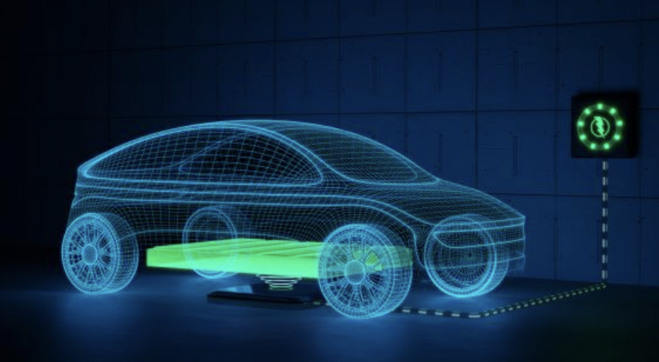
Introduction
Wireless EV charging uses electromagnetic induction to transfer power from a ground pad to a vehicle’s receiver, enabling cable-free charging. The transmitted energy is converted into electricity to charge the battery efficiently. It enhances convenience, safety, and reduces wear and tear. This technology is used in home, public, and dynamic charging systems.

Slide 3

Problem Statement
Traditional EV charging requires physical cables, which can be inconvenient, wear out over time, and limit mobility. The challenge is to develop a wireless EV charging system that efficiently transfers power without direct contact, ensuring high efficiency, safety, and convenience, while minimizing energy losses and costs.

Slide 4

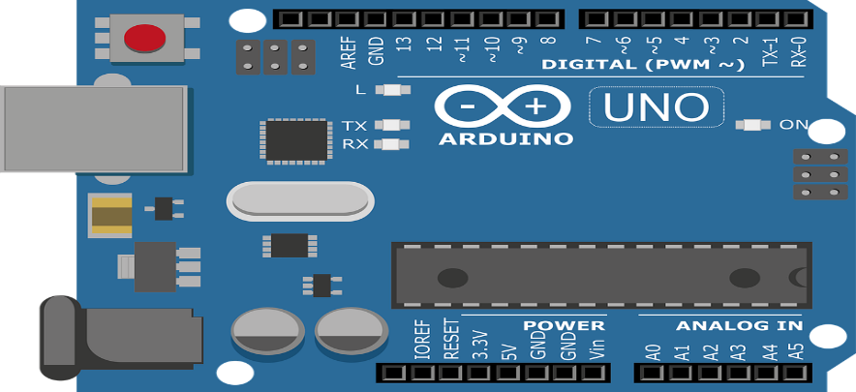
Objective
Develop an efficient and reliable wireless EV charging system.
Ensure safe and contactless power transfer.
Enhance user convenience by eliminating physical connectors.
Design the system to work in various environmental conditions.

Slide 5
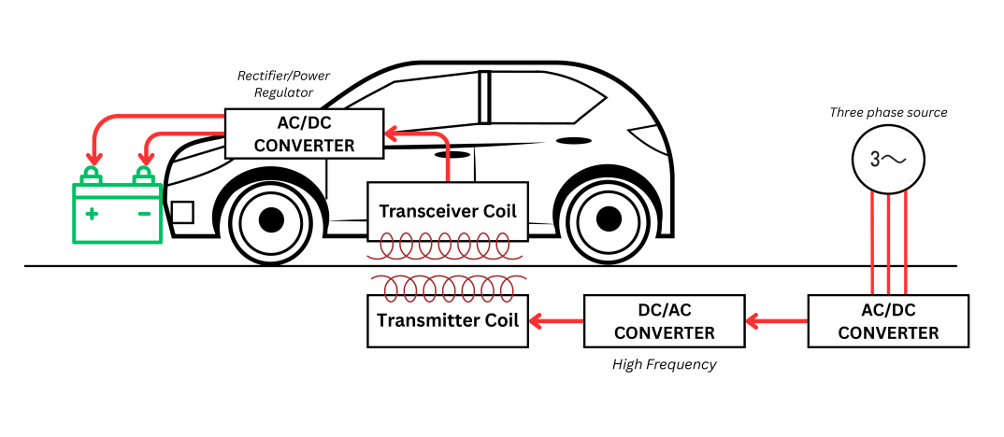
Architectural Diagram

Slide 6
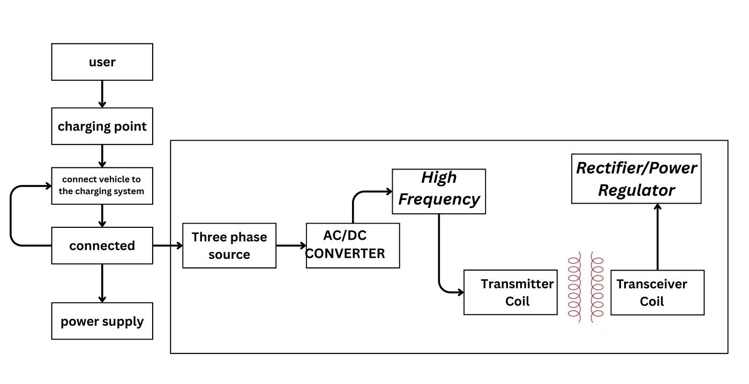
Flow Chart Diagram

Slide 7
Work Plan Till Next Presentation
To make a prototype of the model about which it is discussed in the above slides.
To simulate the whole project and see the working of the whole model.
To figure out what is lacking and to make changes suggested by the guide and the panel.

Slide 8

Conclusion
Wireless EV charging provides a safe, efficient, and convenient solution for powering electric vehicles. It enables seamless, contactless charging, enhancing user experience and supporting the future of smart and autonomous mobility. This technology is set to revolutionize EV infrastructure and drive widespread adoption of electric vehicles.

Slide 9
References
https://ieeexplore.ieee.org/document/8101562
https://www.mdpi.com/2032-6653/15/3/118
https://www.mdpi.com/2719218

